Slide 1
Mid Point Circle Drawing Algorithm
Nancy Victor
Assistant Professor
SITE, VIT University,
Vellore

Slide 2
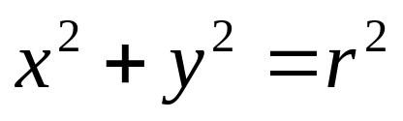
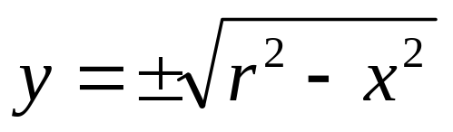
A Simple Circle Drawing Algorithm
The equation for a circle is:
where r is the radius of the circle.
So, we can write a simple circle drawing algorithm by solving the equation for y at unit x intervals using:

Slide 3
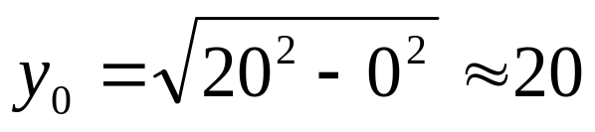
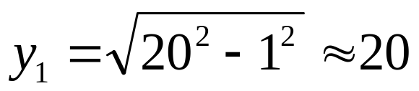
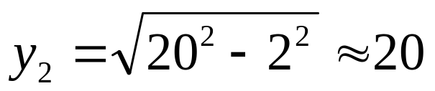
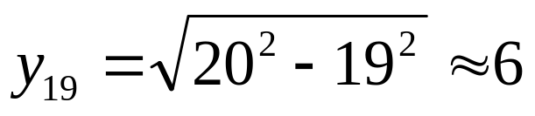
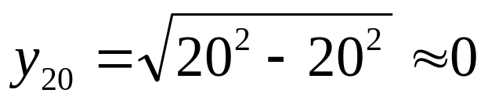
A Simple Circle Drawing Algorithm (cont…)

Slide 4
A Simple Circle Drawing Algorithm (cont…)
Not a brilliant solution!
Firstly, the resulting circle has large gaps where the slope approaches the vertical
Secondly, the calculations are not very efficient
  The square (multiply) operations
  The square root operation – try really hard to avoid these!
We need a more efficient, more accurate solution.

Slide 5

Eight-Way Symmetry
The first thing we can notice to make our circle drawing algorithm more efficient is that circles centred at (0, 0) have eight-way symmetry
(-x, y)
(x, y)
(-y, x)
(y, x)
(-y, -x)
(y, -x)
(-x, -y)
(x, -y)

Slide 6
Mid-Point Circle Algorithm
Similarly to the case with lines, there is an incremental algorithm for drawing circles – the mid-point circle algorithm
In the mid-point circle algorithm we use eight-way symmetry.
Calculate the points for the top right eighth of a circle, and then use symmetry to get the rest of the points

Slide 7
To determine the closest pixel position to the specified circle path at each step.
For given radius r and screen center position (x_{c}, y_{c}), calculate pixel positions around a circle path centered at the co-ordinate origin (0,0).
Then, move each calculated position (x, y) to its proper screen position by adding x_{c} to x and y_{c} to y.

Slide 8
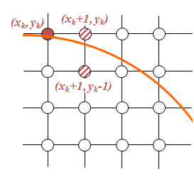
Mid-Point Circle Algorithm (cont…)
Assume that we have
just plotted point (x_{k}, y_{k})
The next point is a
choice between (x_{k}+1, y_{k})
and (x_{k}+1, y_{k}-1)
We would like to choose
the point that is nearest to
the actual circle.

Slide 9
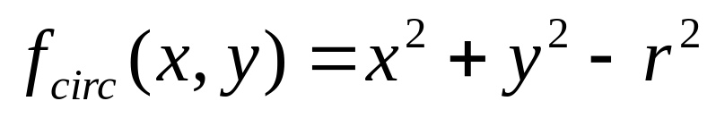
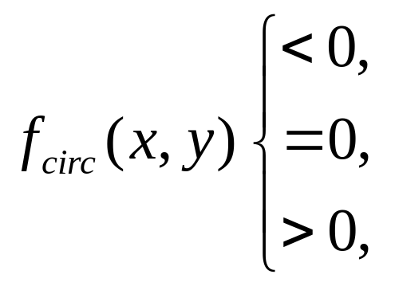
Mid-Point Circle Algorithm
The equation of the circle is re-designed as:
The equation evaluates as follows:
By evaluating this function at the midpoint between the candidate pi

Slide 10
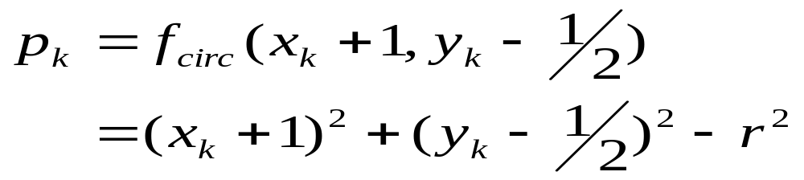
Mid-Point Circle Algorithm
Assuming we have just plotted the pixel at (x_{k},y_{k}) so we need to choose between (x_{k}+1,y_{k}) and (x_{k}+1,y_{k}-1)
Our decision variable can be defined as:
If p_{k} < 0 the midpoint is inside the circle and and the pixel at y_{k} is closer to the circle
Otherwise the midpoint is outside and y_{k}-1 is closer

Slide 11
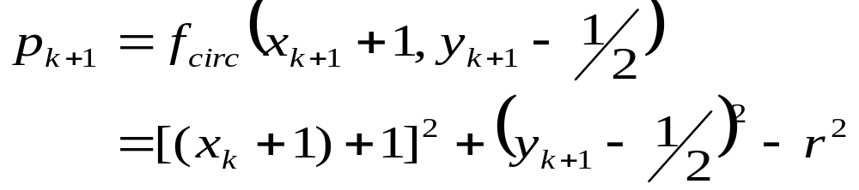
Mid-Point Circle Algorithm
To ensure things are as efficient as possible we can do all of our calculations incrementally
First consider:
or:
where y_{k+1} is either y_{k} or y_{k}-1 depending on the sign of p_{k}

Slide 12
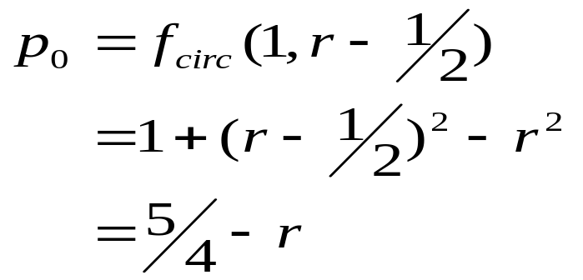
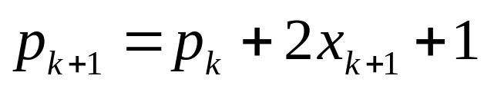
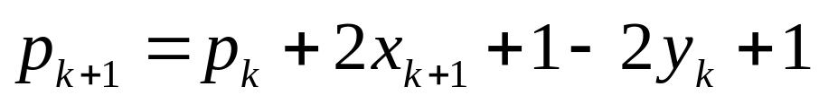
Mid-Point Circle Algorithm
The first decision variable is given as:
Then if p_{k} < 0 then the next decision variable is given as:
If p_{k} > 0 then the decision variable is:

Slide 13
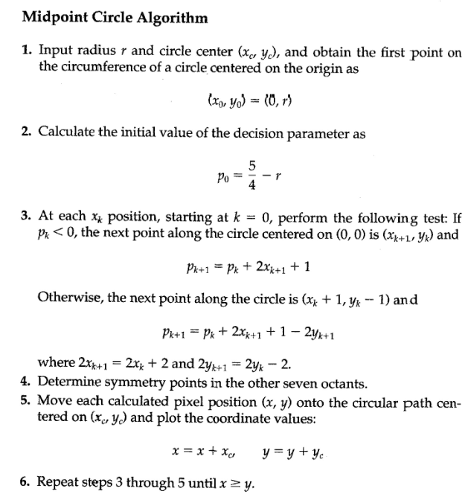
Algorithm

Slide 14
Mid-Point Circle Algorithm Example
To see the mid-point circle algorithm in action lets use it to draw a circle centred at (0,0) with radius 10

Slide 15
Midpoint Circle Drawing Algorithm
For the initial point, (x₀ , y₀₎ = (0, r)
f₀ = f_{circle} (1, r-½ )
= 1 + (r-½ )² – r²
= 5 – r
4
≈ 1 – r

Slide 16
Midpoint Circle Drawing Algorithm
Example:
Given a circle radius = 10, determine the circle octant in the first quadrant from x=0 to x=y.
Solution:
f₀ = 5 – r
4
= 5 – 10
4
= -8.75
≈ –9

Slide 17
Midpoint Circle Drawing Algorithm
Initial (x₀, y₀) = (1,10)
Decision parameters are: 2x₀ = 2, 2y₀ = 20
k | F_{k} | x | y | 2x_{k+1} | 2y_{k+1}
0 | -9 | 1 | 10 | 2 | 20
1 | -9+2+1=-6 | 2 | 10 | 4 | 20
2 | -6+4+1=-1 | 3 | 10 | 6 | 20
3 | -1+6+1=6 | 4 | 9 | 8 | 18
4 | 6+8+1-18=-3 | 5 | 9 | 10 | 18
5 | -3+10+1=8 | 6 | 8 | 12 | 16
6 | 8+12+1-16=5 | 7 | 7 | 14 | 14

Slide 18
Mid-Point Circle Algorithm Example (cont…)
10
k | p_{k} | (x_{k+1},y_{k+1}) | 2x_{k+1} | 2y_{k+1}
0 1 2 3 4 5 6
9
8
7
6
5
4
3
2
1
0
0
1
2
3
4
5
6
7
8
9
10

Slide 19
Mid-Point Circle Algorithm Summary
The key insights in the mid-point circle algorithm are:
  Eight-way symmetry can hugely reduce the work in drawing a circle
  Moving in unit steps along the x axis at each point along the circle’s edge we need to choose between two possible y coordinates

Slide 20
Thank You…

